Slide 1
Angular best practice
12-08-2016
nguyen ngoc san - senior front-end developer

Slide 2
AGENDA
Angular common issues
Form and input
Angular dependency injection
Angular view rendering and $timeout
Q&A

Slide 3

ANGULAR MODULE

Slide 4


Angular pretty URLs
How to remove # on URLs?
Use HTM5 Mode and configure URL rewriting on web server
index.js file:
module.config(["$locationProvider", function ($locationProvider) {
$locationProvider.html5Mode(true);
}]);
index.html file: Add <base> tag
<base href="/“>
Using HTML5 mode requires URL rewriting on server side, basically you have to rewrite all your links to entry point of your application (e.g index.html).
How to configure URL rewriting
Notes:
<number>

Slide 5
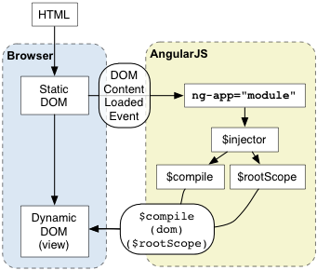
Angular bootstrap
Notes:
https://docs.angularjs.org/guide/bootstrap
Using manual initialization if you need to perform an operation before Angular compiles a page
<number>

Slide 6
Cordova app must use bootstrap
Cannot load html content when using ng-app.
Must execute Angular compile page after device ready event fired. Add the following code in cordova_app/www/index.js file:
this.onDeviceReady = function () {
angular.bootstrap(document, ['myApp']);
};
document.addEventListener('deviceready', this.onDeviceReady, false);
Notes:
<number>

Slide 7
Angular injects third party as service
(function (module) {
"use strict";
module.factory("jQuery", jQueryModule);
jQueryModule.$inject("$window");
function jQueryModule($window) {
return $window.jQuery;
}
})(angular.module("app"));
Notes:
<number>

Slide 8
Angular copy function issue with Blob object
Using angular.copy while editing profile picture to clone the picture and use it later does not work.
Create a cloneBlob function as below:
function cloneBlob (source) {
if (source instanceof Blob) {
return source.slice(); // clone file
}
}

Slide 9
FORM AND INPUT

Slide 10
Angular Form
Sometimes can not get the Form Controller in $scope object.
Template view:
<form name="contactForm">
</form>
Controller:
$scope.contactForm is a form controller object. It will have the following property:
$scope.contactForm.$error
$scope.contactForm.$valid
Template view:
<form name="contactForm"
ng-if="showContactForm"></form>
Controller:
$scope.showContactForm = true;
$scope.contactForm is undefined.
Bind the Form Controller to Controller object.
<form name="formCtrl.contactForm" ng-if="showContactForm"></form>
Controller: controller.contactForm is a form controller object
Notes:
https://docs.angularjs.org/api/ng/directive/form
<number>

Slide 11
Angular Form - Custom Validation
How to define new validation rule for Form input and check it valid in ngModelController.$error.
Create custom directive & use $validators of ngModelController
app.directive(‘customValidation', function() {
return {
require: 'ngModel',
link: function(scope, elm, attrs, ctrl) {
ctrl.$validators. customValidation =
function(modelValue, viewValue) {
return <isValidValue(modelValue)>
};
}
};
});
Notes:
https://docs.angularjs.org/guide/forms
The directive must require ngModel
$validators function receives modelValue & the viewValue as parameters
Validation happens after successfully running $parsers and $formatters
Failed validators are stored by key in ngModelController.$error
<number>

Slide 12
Angular Form Input
ngModelController check validation for all input fields even though they are hidden field.
Using ng-if instead of ng-show/ng-hide
Sometimes cannot get value of input that directly bind with $scope
Create a $scope.data = {}; object. Binding input with $scope.data
Notes:
<number>

Slide 13
DEPENDENCY INJECTION

Slide 14
Angular dependency injection
When the application bootstraps, Angular creates an injector that will be used to find and inject all of the services that are required by your application.
The injector only carries out the following steps:
Load the module definition(s) that you specify in your application.
Register all Providers defined in these module definition(s).
When asked to do so, lazily instantiate services and their dependencies, via their Providers, as parameters to an injectable function.
Notes:
https://docs.angularjs.org/tutorial/step_09
Angular modules solve the problem of removing global variables from the application and provide a way of configuring the injector. As opposed to AMD or require.js modules, Angular modules don't try to solve the problem of script load ordering or lazy script fetching. These goals are totally independent and both module systems can live side-by-side and fulfill their goals.
<number>

Slide 15
Angular circular dependency error
Service A ← Service C ← Service B ← Service A
Using $injector to manual inject in each service’s function.
module.factory("serviceC", [
"$injector",
function ($injector) {
function doSomething() {
var serviceA = $injector.get("serviceA");
serviceA.doSomething();
}
}
]);
Notes:
<number>

Slide 16
VIEW RENDERING & $TIMEOUT

Slide 17
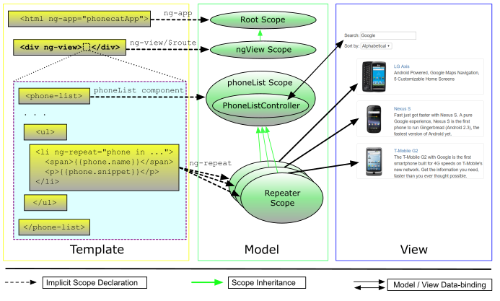
Angular view rendering with ngView
Notes:
https://docs.angularjs.org/api/ngRoute/directive/ngView
$viewContentLoaded
$routeChangeSuccess
If ngView is contained in an asynchronously loaded template (e.g. in another directive's templateUrl or in a template loaded usingngInclude) => Using $timeout to check whether subView is rendered or not.
<number>

Slide 18
ngView contains asynchronously loaded template
View contains ng-include or directives. How to check whether all child views are loaded?
Using $timeout to fire event for parent controller.
Browser render include 2 tasks:
DOM rendering
JS execution
→ Using $timeout(fn). We will push it to JS execution queue and it will be run after DOM rendering.
module.directive("directiveA", [
"$timeout",
function ($timeout) {
return {
scope: {
isLoaded: "="
},
link: function (scope, el, attrs) {
$timeout(function () {
scope.isLoaded = true;
});
}
}
}
]);
Notes:
https://docs.angularjs.org/tutorial/step_09
<number>

Slide 19
Q&A

Slide 20
THANK YOU

